Slide 1



Generative Agents: Interactive Simulacra of Human Behavior
Joon Sung Park, Joseph C. O’Brien, Carrie J. Cai, Meredith Ringel Morris,
Percy Liang and Michael S. Bernstein
Stanford University, Google Research, Google DeepMind
Shen Yuan
2023-10-12

Slide 2
Outline
Introduction
Generative agent behavior and interaction
Generative agent architecture
Sandbox environment implementation
Controlled evaluation
End-to-end evaluation
Discussion
Conclusion

Slide 3
Introduction
Generative agent behavior and interaction
Generative agent architecture
Sandbox environment implementation
Controlled evaluation
End-to-end evaluation
Discussion
Conclusion

Slide 4
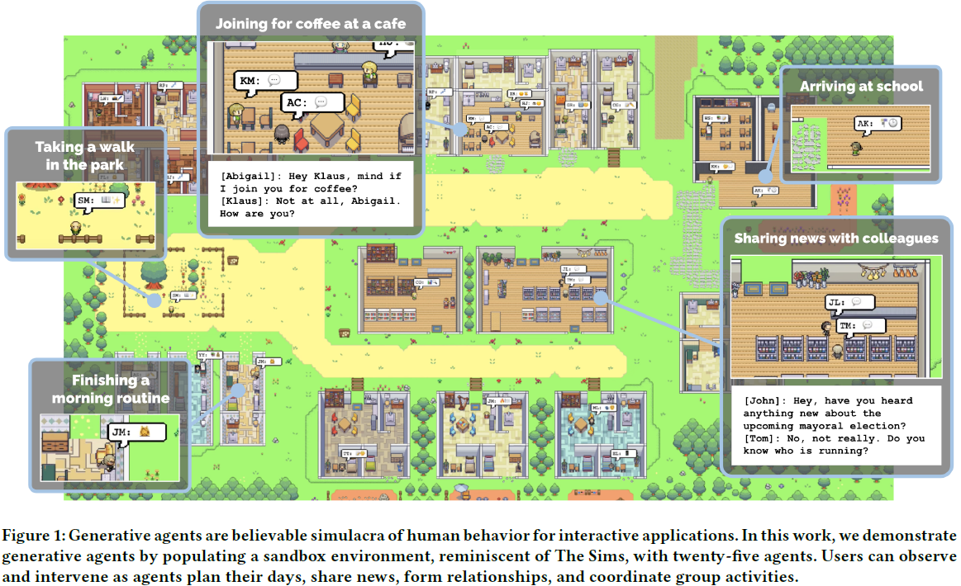
Introduction
Notes:
Overview of this work.
This work is different from the other papers. There isn’t any mathematical formula or complex proof in this work, instead of experiments, observations and anlysis. the authors used large language model to simulate a sandbox environment and 25 generative agents, and observe their actions.

Slide 5
Contributions
Generative agents
A novel architecture that makes it possible for generative agents to remember, retrieve, reflect, interact with other agents, and plan through dynamically evolving circumstances.
The architecture leverages the powerful prompting capabilities of large language models and supplements those capabilities to support longer-term agent coherence, the ability to manage dynamically evolving memory, and recursively produce higher-level reflections.
Two evaluations, a controlled evaluation and an end-to-end evaluation, that establish causal effects of the importance of components of the architecture, as well as identify breakdowns arising from, e.g., improper memory retrieval.
Notes:
Second, it’s memory stream …

Slide 6
Introduction
Generative agent behavior and interaction
Generative agent architecture
Sandbox environment implementation
Controlled evaluation
End-to-end evaluation
Discussion
Conclusion

Slide 7






Agent Avatar and Communication
A community of 25 unique agents inhabits Smallville.
Each agent is represented by a simple sprite avatar.
For instance, John Lin has the following description including their occupation and relationship with other agents:
Notes:
Every agent will have an initial memory

Slide 8


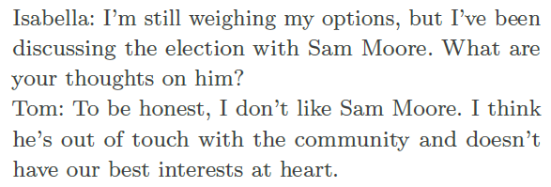

Inter-Agent Communication
The agents interact with the world by their actions, and with each other through natural language.
“Isabella Rodriguez is writing in her journal” is displayed as
“Isabella Rodriguez is checking her emails” appears as
Agents communicate with each other in full natural language.
Notes:
Isabella and Tom are talking about the election with Sam.

Slide 9
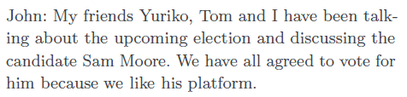
User Controls
The user communicates with the agent through natural language by specifying a persona that the agent should perceive them as.
If the user specifies that they are a news “reporter” and asks about the upcoming election by saying, “Who is running for office?”, the John agent replies:
Notes:
that’ to say, we can change the sandbox from the outside.

Slide 10
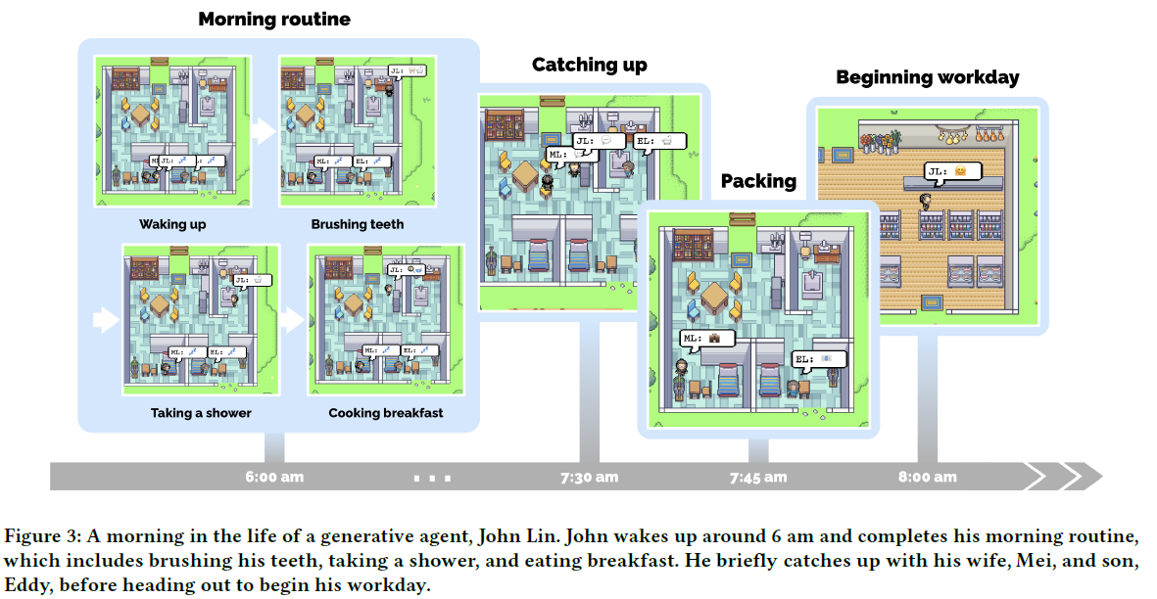
Example “Day in the Life”
Time series sampled from an underlying (continuous) physical process
Notes:
This is an example Day in the Life of John’s home.

Slide 11
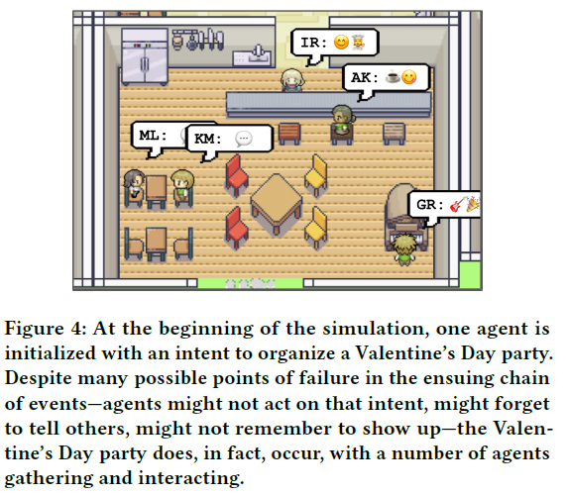
Emergent Social Behaviors
By interacting with each other, generative agents in Smallville could do:
Information Diffusion. Information can spread from agent to agent.
Relationship Memory. Agents in Smallville form new relationships over time and remember their interactions with other agents.
Coordination. Generative agents coordinate with each other.
Notes:
Except for routine, there are many Emergent Social Behaviors.
exchange information, form new relationships, and coordinate joint activities.
Here is an example of Valentine’s Day party. At the very beginning, just because Isabella has a plan to organize a Valentine’s Day party.
By the information diffusion, many agents heard about this plan. They coordinate with each other to organize this party. And in this party, they form new relationship.

Slide 12
Introduction
Generative agent behavior and interaction
Generative agent architecture
Sandbox environment implementation
Controlled evaluation
End-to-end evaluation
Discussion
Conclusion
Notes:
So, how to make this agents act like a real human.

Slide 13
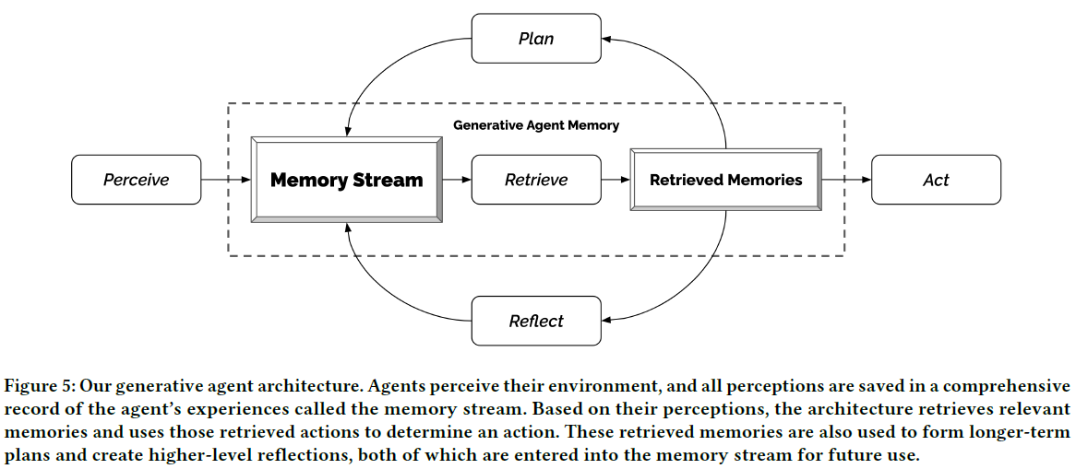
Generative Agent Architecture
Notes:
Let’s take a look in detail. First, it’s the retrieval.

Slide 14
Memory and Retrieval
Challenge: the full memory stream is far larger than what should be described in a prompt, and does not even currently fit into the limited context window.
Approach:
Memory Stream maintains a comprehensive record of the agent’s experience. It is a list of memory objects, where each object contains a natural language description, a creation timestamp, and a most recent access timestamp.
Observation is the most basic element of the memory stream, which is an event directly perceived by an agent.
Retrieval that takes the agent’s current situation as input and returns the most relevant subset of the memory stream to pass on to the language model.
Notes:
Creating generative agents that can simulate human behavior, that will require reasoning about a large set of experiences or the full memory stream that is far larger than a prompt, and does not even fit into the limited context window.

Slide 15
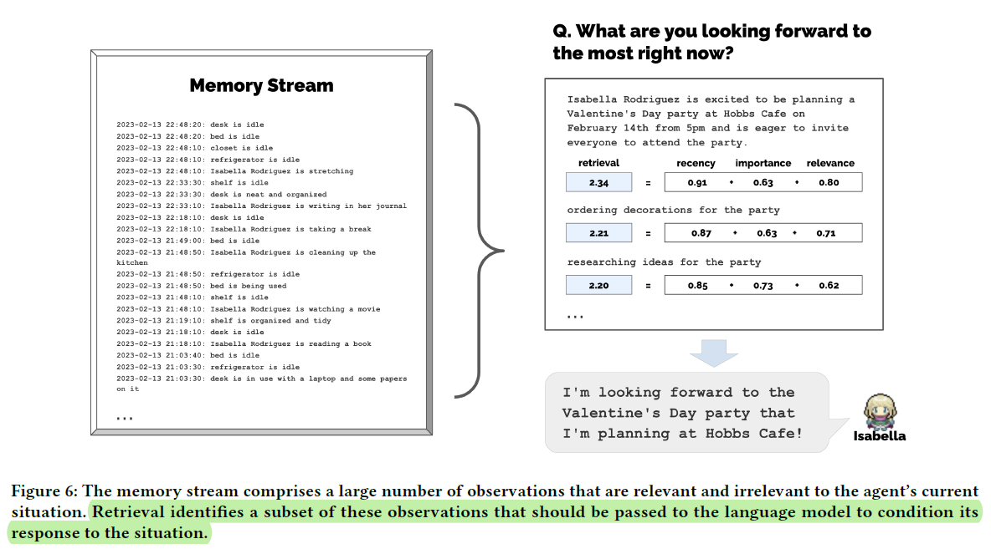
Long "Continuous" Time Series
Time series sampled from an underlying (continuous) physical process

Slide 16
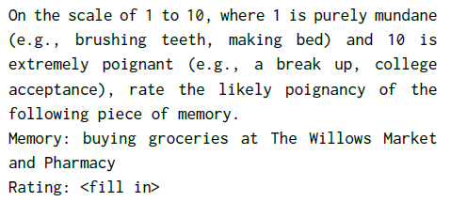
Retrieval
Recency assigns a higher score to memory objects that were recently accessed.
Importance distinguishes mundane from core memories by assigning a higher score to memory objects that the agent believes to be important.
Relevance assigns a higher score to memory objects that are related to the current situation.
Notes:
In the implementation, the authors treat recency as an exponential decay function.
Our decay factor is 0.995.
the authors find that directly asking the language model to output a score is effective. The full prompt is here:
the authors use the language model to generate an embedding vector of each memory.
Then, calculate relevance as the cosine similarity between the memory’s embedding vector and the query memory’s embedding vector.

Slide 17
Reflection
Challenge: Generative agents, when equipped with only raw observational memory, struggle to generalize or make inferences.
Approach:
Reflection, the second type of memory.
Reflections are higher-level, more abstract thoughts generated by the agent.
Reflections can be included alongside other observations when retrieval occurs.
Reflections are generated periodically when the sum of the importance scores for the latest events perceived by the agents exceeds a threshold (150 in our implementation).
Notes:
That’s to say, we need a higher-level, and more abstract memory.

Slide 18
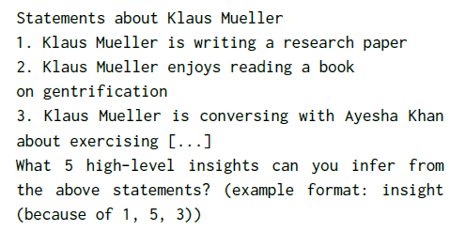
Reflection
Steps:
Query the large language model with the 100 most recent records in the agent’s memory stream
Prompt the language model, “Given only the information above, what are 3 most salient high-level questions we can answer about the subjects in the statements?”
The model’s response generates candidate questions.
Use these generated questions to prompt the language
model to extract insights.
e.g., “Klaus Mueller is reading a book on gentrification”, “Klaus Mueller is conversing with a librarian about his research project”, “desk at the library is currently unoccupied”
e.g., What topic is Klaus Mueller passionate about? and What is the relationship between Klaus Mueller and Maria Lopez?

Slide 19
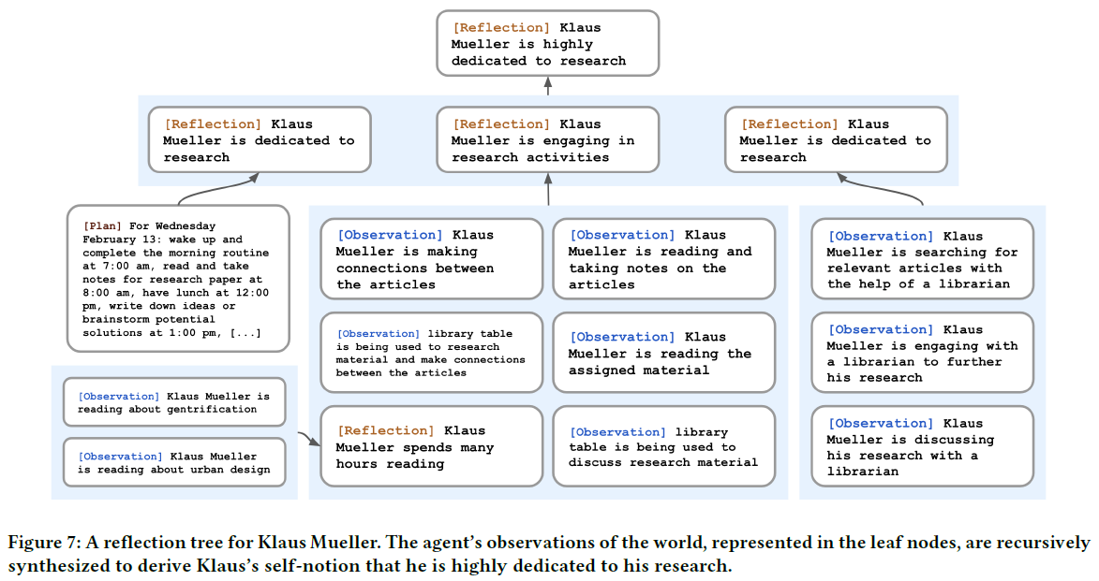
Reflection

Slide 20
Planning and Reacting
Challenge: agents need to plan over a longer time horizon to ensure that their sequence of actions is coherent and believable.
Approach:
Plans describe a future sequence of actions for the agent, and help keep the agent’s behavior consistent over time.
A plan includes a location, a starting time, and a duration.
Like reflections, plans are stored in the memory stream and are included in the retrieval process.
To create such plans, the approach starts top-down and then recursively generates more detail.

Slide 21
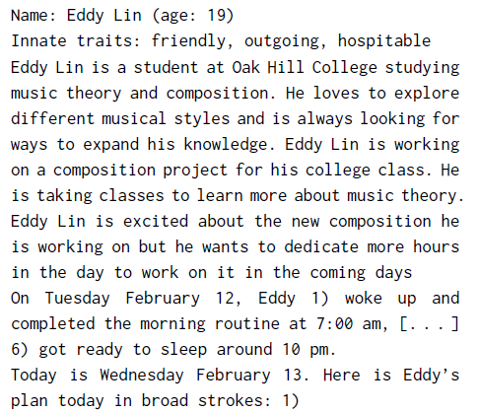
Planning and Reacting
To create such plans, our approach starts top-down and then recursively generates more detail.
Work on his new music composition from 1:00 pm to 5:00 pm
1:00 pm: start by brainstorming some ideas for his music composition
[...]
4:00 pm: take a quick break and recharge his creative energy before reviewing and polishing his composition.
Notes:
To create the initial plan, we prompt the language model with the agent’s summary description.
decompose it to

Slide 22
Introduction
Generative agent behavior and interaction
Generative agent architecture
Sandbox environment implementation
Controlled evaluation
End-to-end evaluation
Discussion
Conclusion

Slide 23
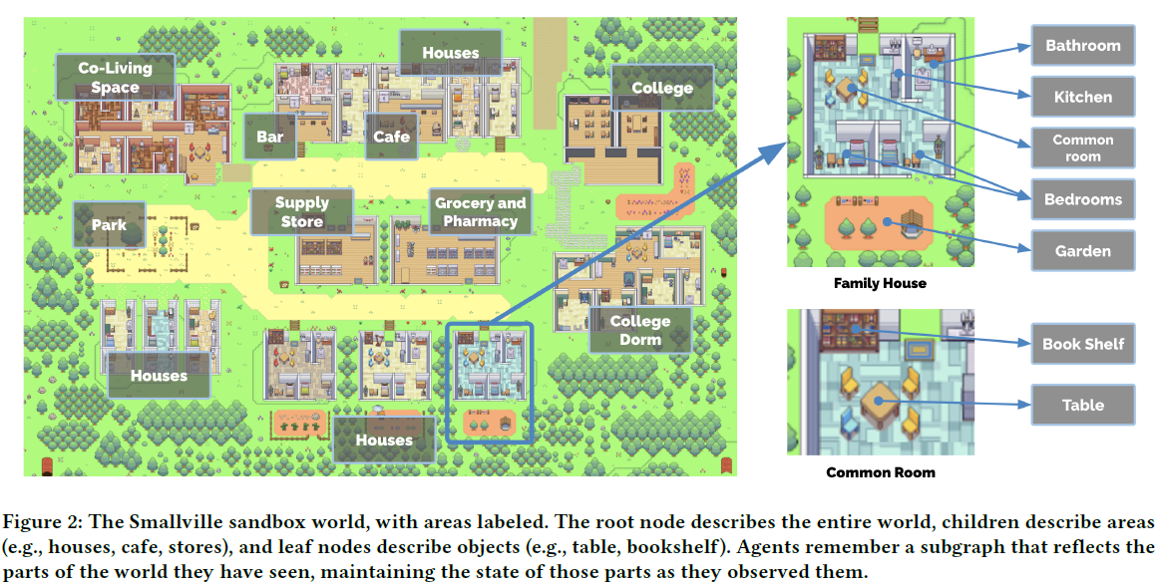
Long "Continuous" Time Series
Time series sampled from an underlying (continuous) physical process
Notes:
This part is not the focus of the work. So let’s take a look quickly.

Slide 24
Introduction
Generative agent behavior and interaction
Generative agent architecture
Sandbox environment implementation
Controlled evaluation
End-to-end evaluation
Discussion
Conclusion

Slide 25
Evaluation Procedure
The authors “interview” agents to probe their ability to remember past experiences, plan future actions based on their experiences, react appropriately to unexpected events, and reflect on their performance to improve their future actions.
The interview includes five question categories:
Self-knowledge: We ask questions such as “Give an introduction of yourself” or “Describe your typical weekday schedule in broad strokes” that require the agent to maintain an understanding of their core characteristics.
Memory: We ask questions that prompt the agent to retrieve particular events or dialogues from their memory to answer properly, such as “Who is [name]?” or “Who is running for mayor?”
Plans: We ask questions that require the agent to retrieve their long-term plans, such as “What will you be doing at 10 am tomorrow?”
Reactions: As a baseline of believable behavior, we present hypothetical situations for which the agent needs to respond believably: “Your breakfast is burning! What would you do?”
Reflections: We ask questions that require the agents to leverage their deeper understanding of others and themselves gained through higher-level inferences, such as “If you were to spend time with one person you met recently, who would it be and why?”
Notes:
The authors leverage the fact that generative agents will respond to natural language questions.

Slide 26
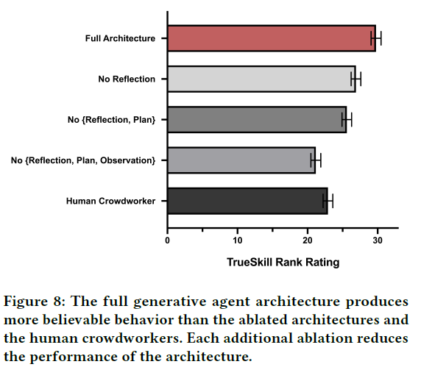
Results
Notes:
The performance is evaluated by Human Evaluators.
the full architecture of generative agents generates the most believable behavior.
The authors want to identify whether the architecture meets a basic level of behavioral competency

Slide 27
Problems
Generative agents maybe fail to retrieve the correct instances from their memory.
When asked about the local election, Rajiv Patel responded with “I haven’t been following the election too closely,” even though he had heard about Sam’s candidacy.
In some cases, the agents would retrieve an incomplete memory fragment: when Tom was asked about Isabella’s Valentine’s Day party, he responded “Uh, I’m actually not sure if there is a Valentine’s Day party. But I do remember that I need to discuss the upcoming local mayoral election and my thoughts on Sam Moore with Isabella Rodriguez at the party, if one is happening!”
At times, the agents hallucinated embellishments to their knowledge.
Isabella said that “Sam’s going to make an announcement tomorrow”, however, Sam and Isabella had not discussed any such plans.
Agents may also embellish their knowledge based on the world knowledge encoded in the language model used to generate their responses.
This was observed when Yuriko described her neighbor, Adam Smith, as an economist who “authored Wealth of Nations”, a book written by an 18th-century economist of the same name.

Slide 28
Introduction
Generative agent behavior and interaction
Generative agent architecture
Sandbox environment implementation
Controlled evaluation
End-to-end evaluation
Discussion
Conclusion
Notes:
Controlled evaluation is mainly for each agent, while End-to-end evaluation is for the entire community.

Slide 29
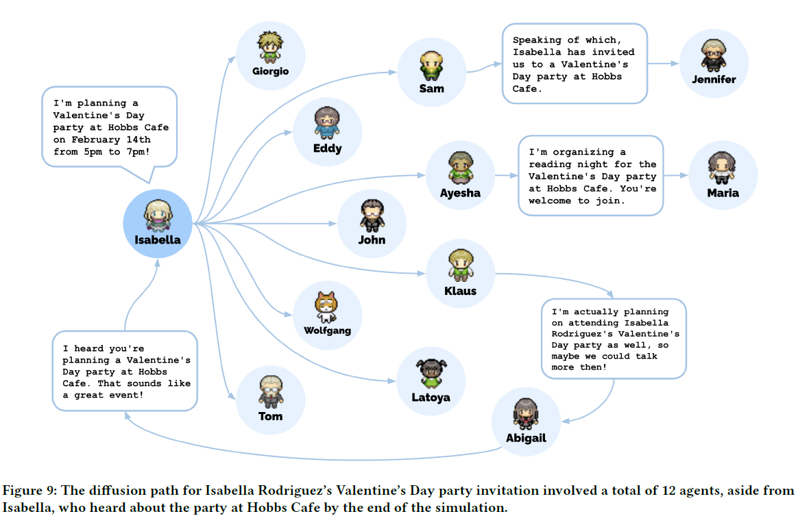
Long "Continuous" Time Series
Time series sampled from an underlying (continuous) physical process
Notes:
The authors measure the spread of information in the game: Isabella’s Valentine’s Day party.
The process I think isnot important, let’s skip it.

Slide 30
Problems
The authors noticed erratic behaviors caused by misclassification of what is considered proper behavior, especially when the certain locations that are hard to describe in natural language.
For instance, the college dorm has a bathroom that can only be occupied by one person despite its name, but some agents assumed that the bathroom is for more than one person because dorm bathrooms tend to support multiple people concurrently and choose to enter it when another person is inside.
Likewise, agents in Smallville may not realize that certain places are closed after a certain hour and still decide to enter them. For instance, the stores in Smallville all close around 5 pm, but occasionally, a few agents enter the store after 5 pm.
The authors observed possible effects of instruction tuning, which seemed to guide the behavior of the agents to be too polite and cooperative overall.
When Mei talked with her husband John, she often ended the conversation too formally , “It was good talking to you as always.”

Slide 31
Introduction
Generative agent behavior and interaction
Generative agent architecture
Sandbox environment implementation
Controlled evaluation
End-to-end evaluation
Discussion
Conclusion

Slide 32
Future Work and Limitations
Cost-effective. The present study simulated 25 agents for two days, costing thousands of dollars in token credits and taking multiple days to complete.
More effective performance testing. Future research should aim to observe the behavior of generative agents over an extended period to gain a more comprehensive understanding of their capabilities and establish rigorous benchmark.
Robustness. The robustness of generative agents is still largely unknown. They may be vulnerable to prompt hacking, memory hacking, and hallucination.
Biases of LLM. Any imperfections in the underlying LLM will be inherited by generative agents. Given the known biases of language models, generative agents may potentially exhibit biased behavior or stereotypes.
OOD. Generative agents may struggle to generate believable behavior for certain subpopulations, particularly marginalized populations, due to limited data availability.
Notes:
disabled people

Slide 33
Introduction
Generative agent behavior and interaction
Generative agent architecture
Sandbox environment implementation
Controlled evaluation
End-to-end evaluation
Discussion
Conclusion

Slide 34
Conclusion
This paper introduces generative agents that simulate human behavior.
The authors describe an architecture for generative agents that provides a mechanism for storing a comprehensive record of an agent’s experiences, deepening its understanding of itself and the environment through reflection, and retrieving a compact subset of that information to inform the agent’s actions.
Evaluations suggest that the architecture creates believable behavior.

Slide 35
Thank You for listening!
Shen Yuan
2023-10-12

Slide 36
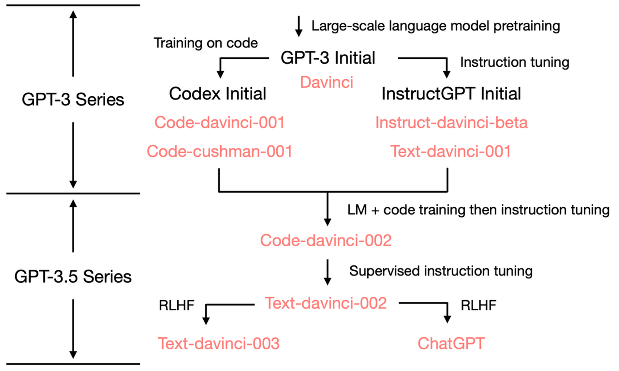
Long "Continuous" Time Series
Time series sampled from an underlying (continuous) physical process

Slide 37
